Slide 1
Cell Tech Database
Fab 5: Hunter Wakefield, Mingxin Chen, Kyla James, Courtney Baker, Yahye Abdi

Slide 2
Contents
Organization Description and Business Problem
What is This Project?
Database Showcase
Analytics
Resolution

Slide 3
Scenario/Business Problem
Cell Tech specializes in prebuilt custom personal computers based on a rotating, limited inventory.
They currently record all customer data on a Word doc and have to consistently lookup specifications for each part that a customer chooses.
By creating an updatable database for Cell Tech we aim to aid them in record keeping and cut down on their research time by providing an easily accessible form to hold customer data.
This customer data table will update frequently while related tables, such as the CPU table, may be updated once a year.

Slide 4
What is Our Project About?
This project aims to be an order processing aid and record keeper, all in one.
With this proposed system internal users are able to add customer information and the parts that they ordered.
The system will then calculate the cost of the entire computer and display it alongside the rest of the customer’s information.
External users are able to view a detailed breakdown of specifications for each part that Cell Tech offers.
This system also allows them to find what parts will best work for their desired specs and budget by providing an easily accessible space that displays such information.

Slide 5
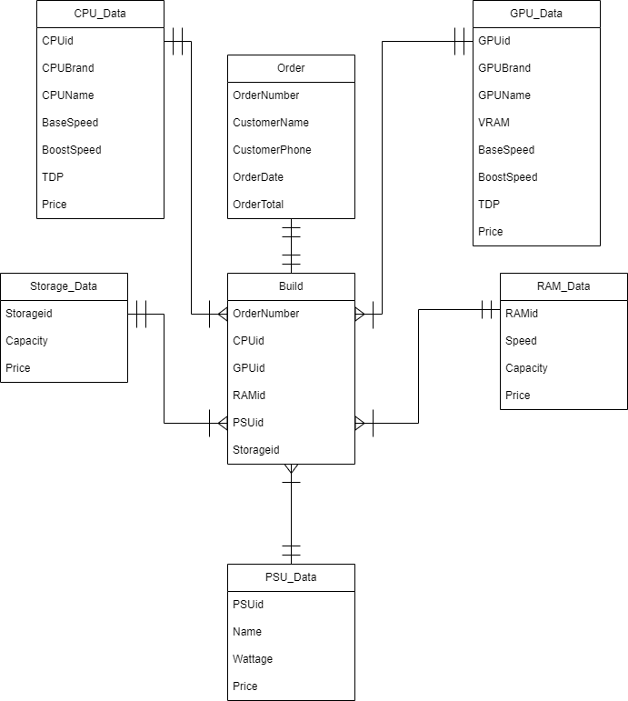
Database Showcase - Data Modeling
This model shows the entire structure of the database. One thing to note is the redundant relationship between part and build that exists for each component.

Slide 6
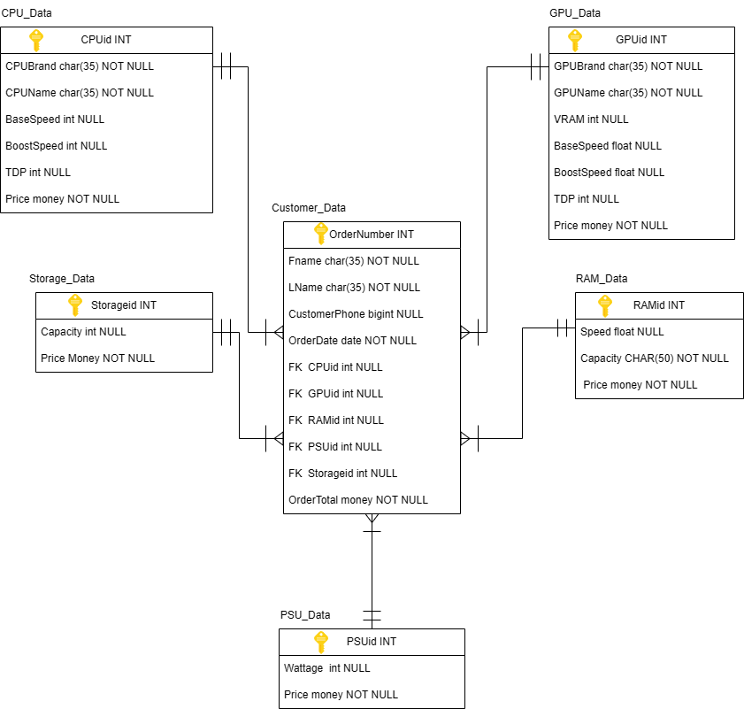
Final Database Design

Slide 7
Database Showcase - Data Generation
The first thing we did after creating a rough model of our database was create tables in Excel for each entity. This was the easiest way to not only get our ideas in order, but also semi-automate the creation of order data and inventory. The only hard data we used came from sources such as Microcenter.com in order to get pricing and specifications.

Slide 8
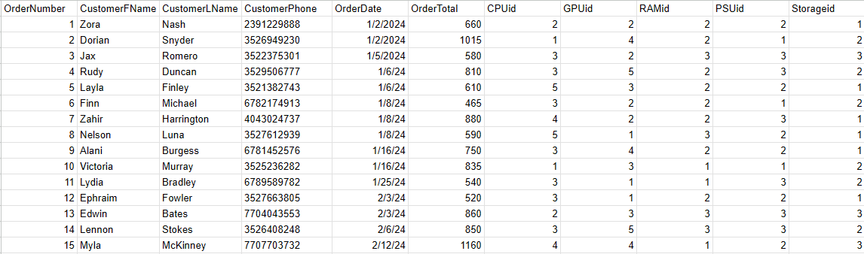
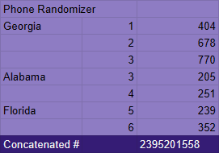
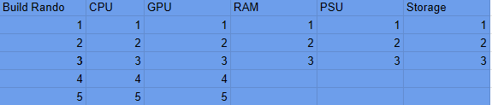
Customer/Order Data
Build Randomizer Phone Number randomizer

Slide 9
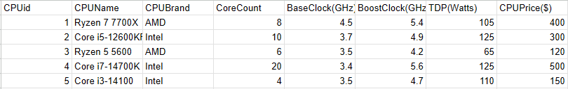
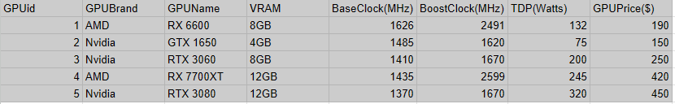
CPU
GPU

Slide 10



RAM
PSU Storage

Slide 11
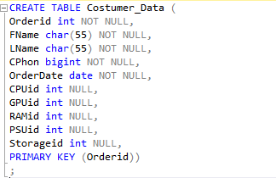
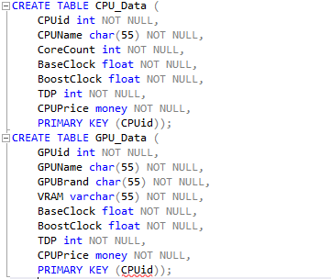
Database Showcase - Table Creation

Slide 12
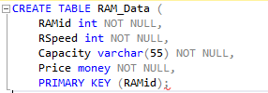



Slide 13
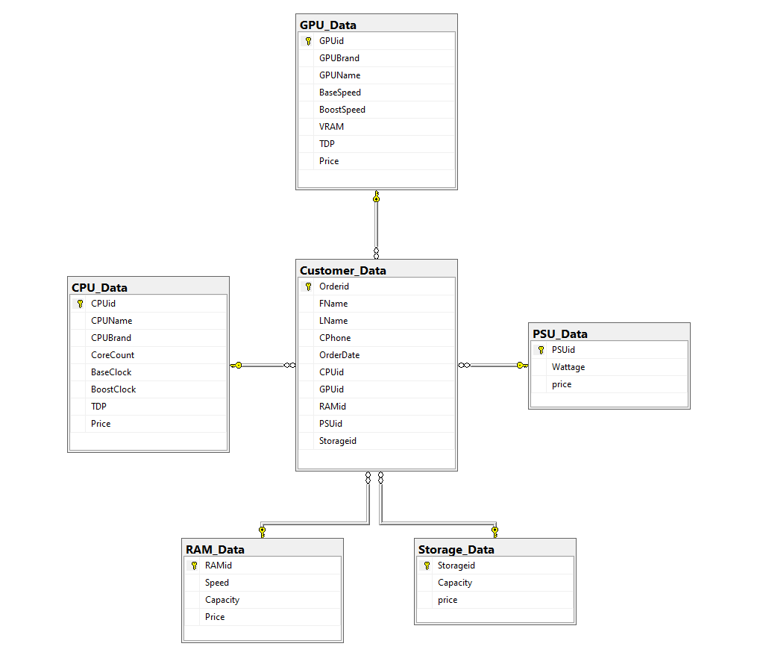
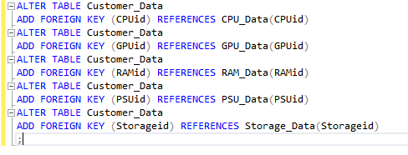
Database Showcase - Final Structure
After the initial tables were created and filled with data, foreign key constraints were added to the Customer_Data table to get a final relational design of what pictured on the right.

Slide 14
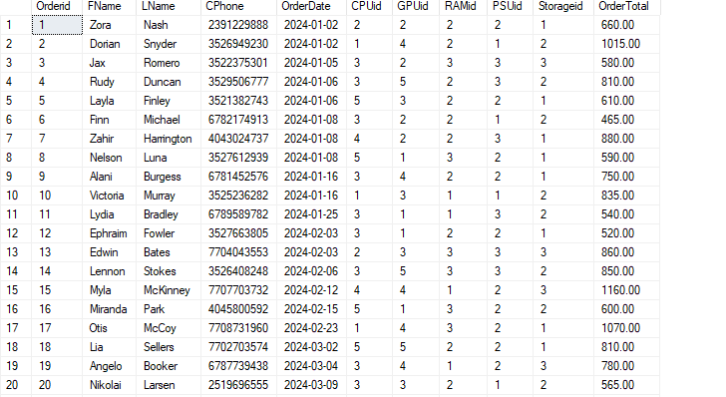
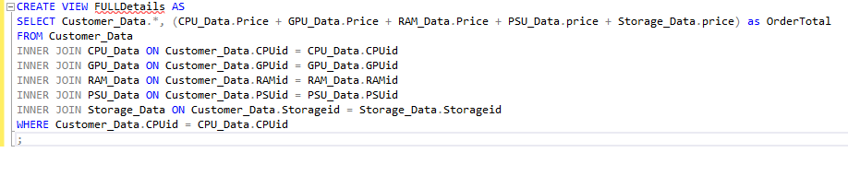
Database Showcase - Create View
In order to get the total cost of each order, we created a view that combines the Customer_Data table and a new column.

Slide 15
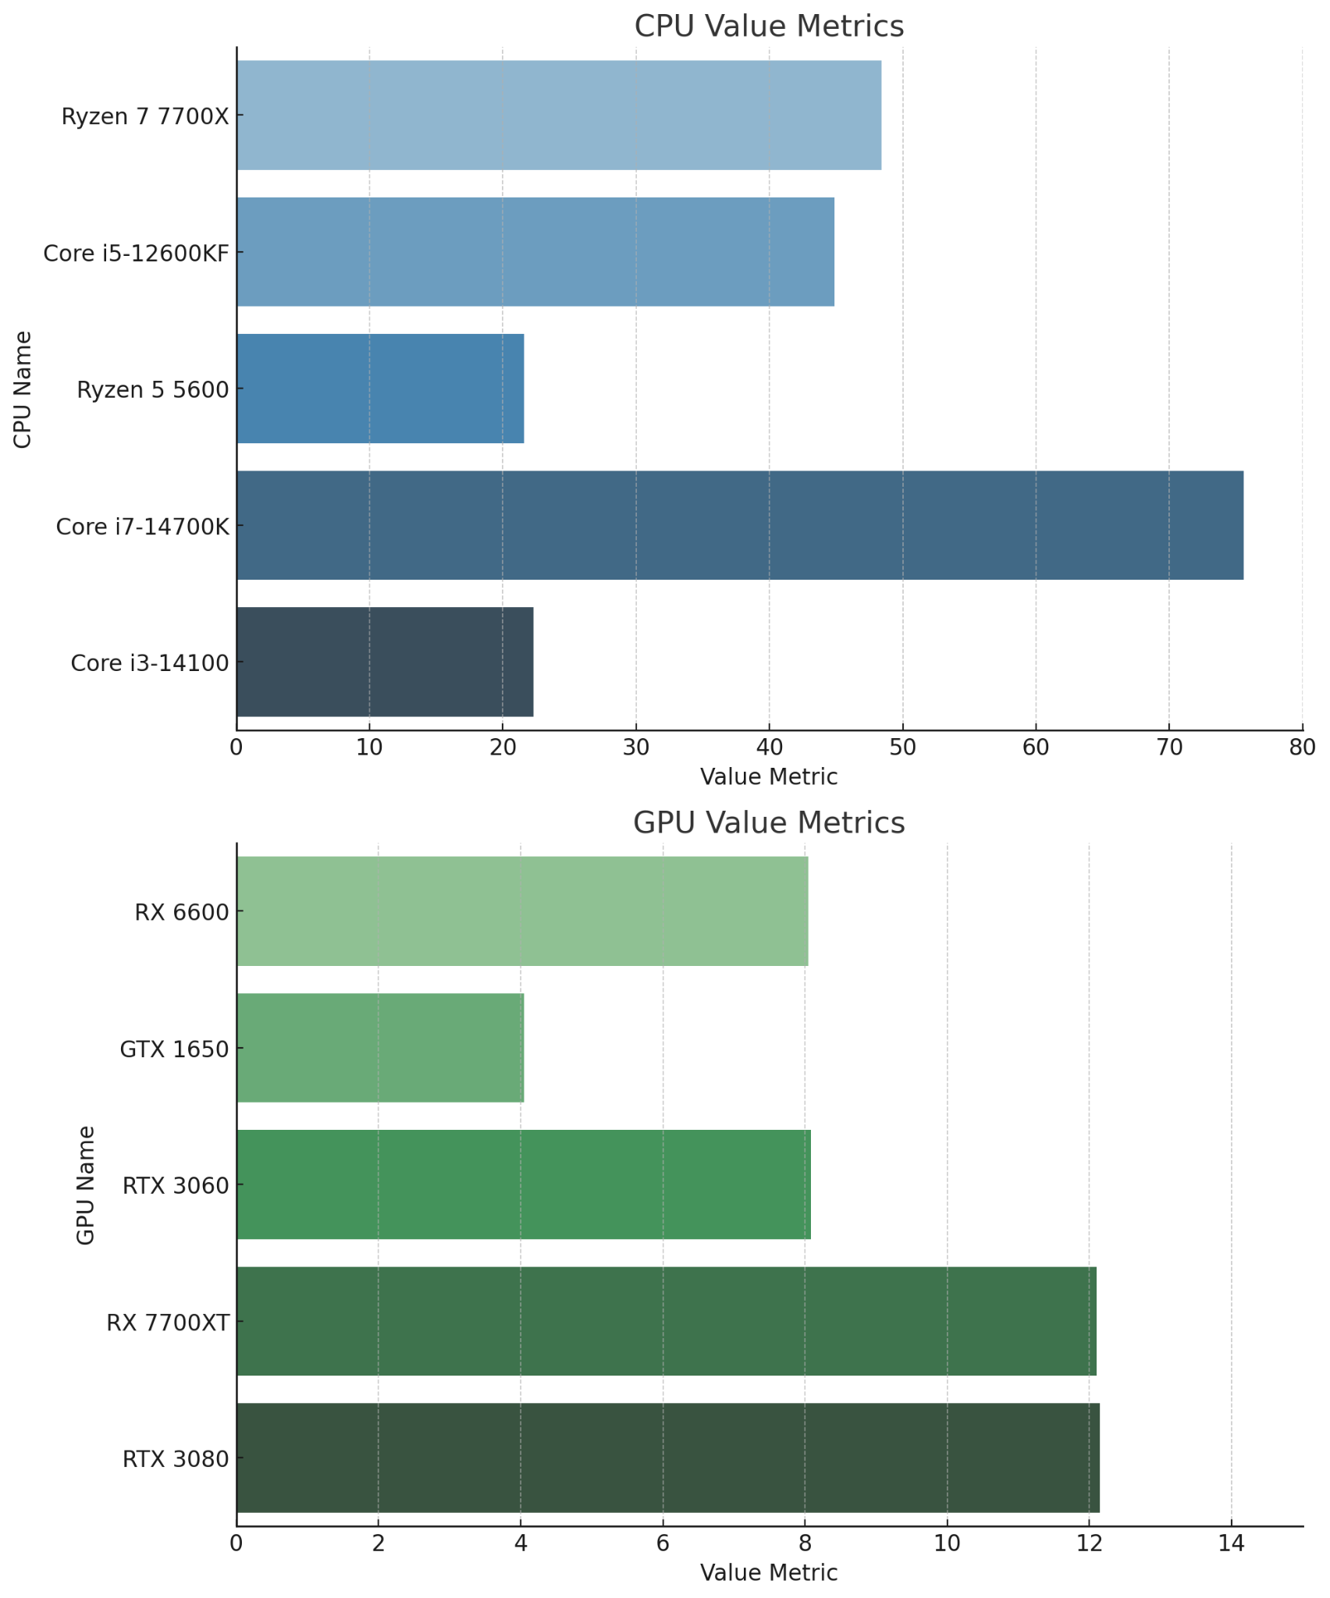
Analytics - CellTech Performance Metrics
CPU Value Metric: Price divided by the sum of base and boost clock speeds, plus the number of cores.
GPU Value Metric: Price divided by the sum of base and boost clock speeds, plus the VRAM in GB.

Slide 16
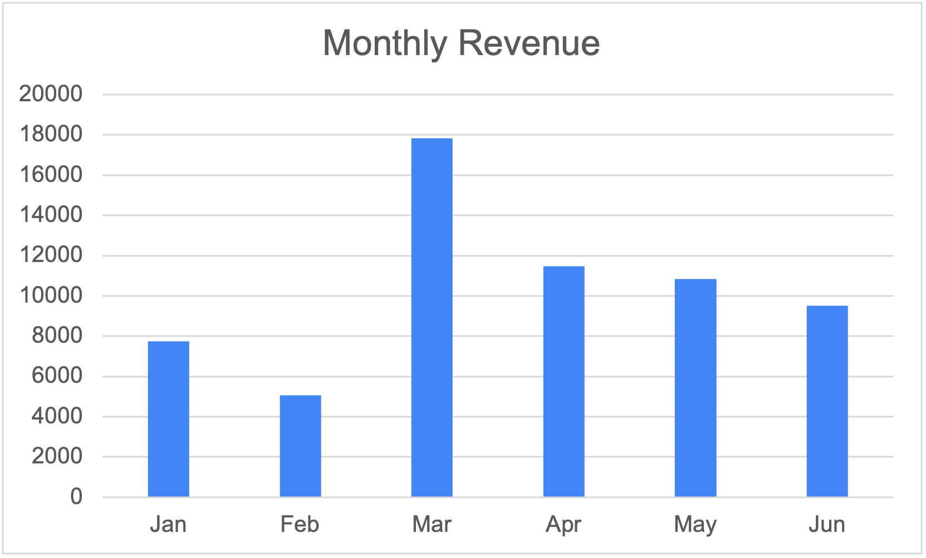
Analytics - Monthly Revenue
During March, Cell Tech ran a promotion advertising points toward new components or another system with the purchase of a complete system. This promotion ran throughout the entire month with moderate success.
Due to the success of the promotion, our revenue was the highest in the months of March and April.

Slide 17
How Did This Database Solve The Problem?
By providing a comprehensive catalog of PC parts along with their specifications and prices, the dataset enables users to compare different components based on their needs and budget. It can be used to:
Compare Components: Users can compare prices and features of different parts to make cost-effective decisions.
Build Configurations: Users can build and optimize PC configurations based on specific requirements like gaming, productivity, or general use.
Identify Trends: Businesses can analyze trends in component prices and popularity for strategic decisions, especially in times of seasonal promotions.

Slide 18
Software and Tools Used
Kaggle
Excel
Draw.io
Microsoft SQL Server

Slide 19
Q&A

